Slide 1



CAR ACCIDENT DETECTOR AND INFORMER
CODE RIDERS
“The only way to discover the limits of the possible is to go beyond them into the impossible.”
–Arthur C. Clarke
SHUBHAM
KUMAR
SINGH
JAHANVI
SHARMA
VAIBHAV
SINGH

Slide 2
Problem Statement
Now a day's foundation has grown however the no. of accidents are additionally getting increased despite the fact that numerous accidents are minor however because of absence of medical aid and the range of rescue vehicle to the spot is late so there is countless
individuals are losing the life consistently
Solution :
Instant Notification to Hospital/Ambulance in case of
accident.
Instant medical support to the injured person.
Instant information to the driver family.
Sound alarm information to locals present in the area.
Information regarding the car movement and history of car movement.
Instant notification to police station and hence easy
finding the reason of accident.

Slide 3
HARDWARE INTERFACE :
01
Power supply with processor
02
Arduino
Accelerometer with processor
Gsm with Processor as input and output.
Gps with processor as input and output and device tracker
Display unit for output from processor.
03

Slide 4
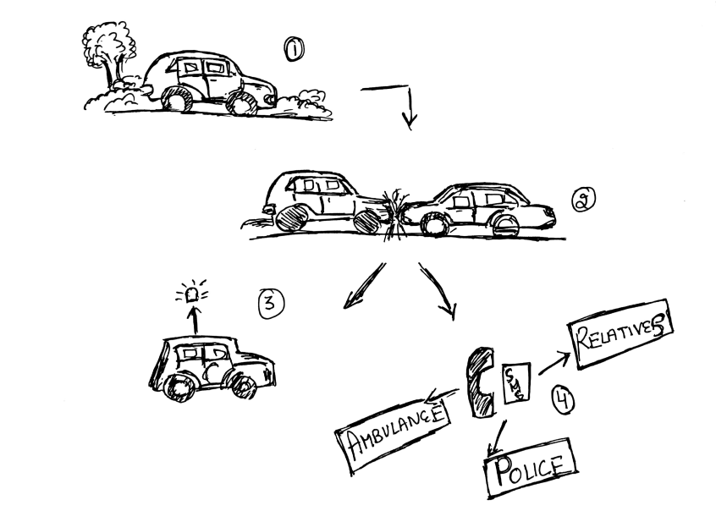
IN THE AVOBE DIAGRAM :
At first point car is moving
And then suddenly an accident take place at alone place or anywhere .
It will also help in notifying near by person by its sound system.
Then our accidential and informer system will notify to person’s family / relatives , to police & to ambulance or nearby hospital

Slide 5
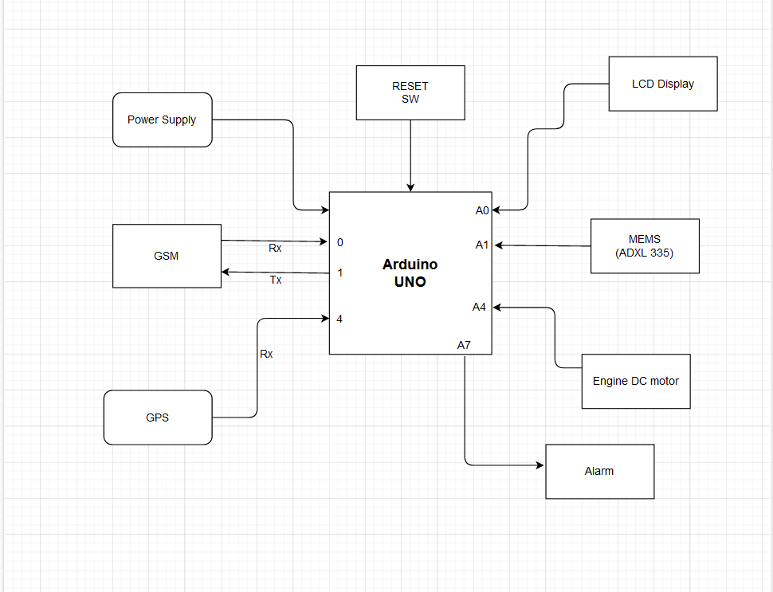
BASIC DIAGRAM OF OUR CIRCUIT WITH MODULES

Slide 6
CODE FOR ACCIDENT LOCATION DETECTOR AND FOR SENDING MESSAGES
void initModule(String cmd, char *res, int t)
{
while(1)
{
Serial.println(cmd);
Serial1.println(cmd);
delay(100);
while(Serial1.available()>0)
{
if(Serial1.find(res))
{
Serial.println(res);
delay(t);
return;
}
else
{
Serial.println("Error");
}
}
delay(t);
}
}

Slide 7
void setup()
{
Serial1.begin(9600);
Serial.begin(9600);
lcd.begin(16,2);
lcd.print("Accident Alert ");
lcd.setCursor(0,1);
lcd.print(" System ");
delay(2000);
lcd.clear();
lcd.print("Callibrating ");
lcd.setCursor(0,1);
lcd.print("Acceleromiter");
for(int i=0;i<samples;i++)
{
xsample+=analogRead(x);
ysample+=analogRead(y);
zsample+=analogRead(z);
}
xsample/=samples;
ysample/=samples;
zsample/=samples;
Serial.println(xsample);
Serial.println(ysample);
Serial.println(zsample);

Slide 8
void loop()
{
int value1=analogRead(x);
int value2=analogRead(y);
int value3=analogRead(z);
int xValue=xsample-value1;
int yValue=ysample-value2;
int zValue=zsample-value3;
Serial.print("x=");
Serial.println(xValue);
Serial.print("y=");
Serial.println(yValue);
Serial.print("z=");
Serial.println(zValue);
if(xValue < minVal || xValue > MaxVal || yValue < minVal || yValue > MaxVal || zValue < minVal || zValue > MaxVal) { get_gps(); show_coordinate(); lcd.clear(); lcd.print("Sending SMS "); Serial.println("Sending SMS"); Send(); Serial.println("SMS Sent"); delay(2000); lcd.clear(); lcd.print("System Ready"); }

Slide 9
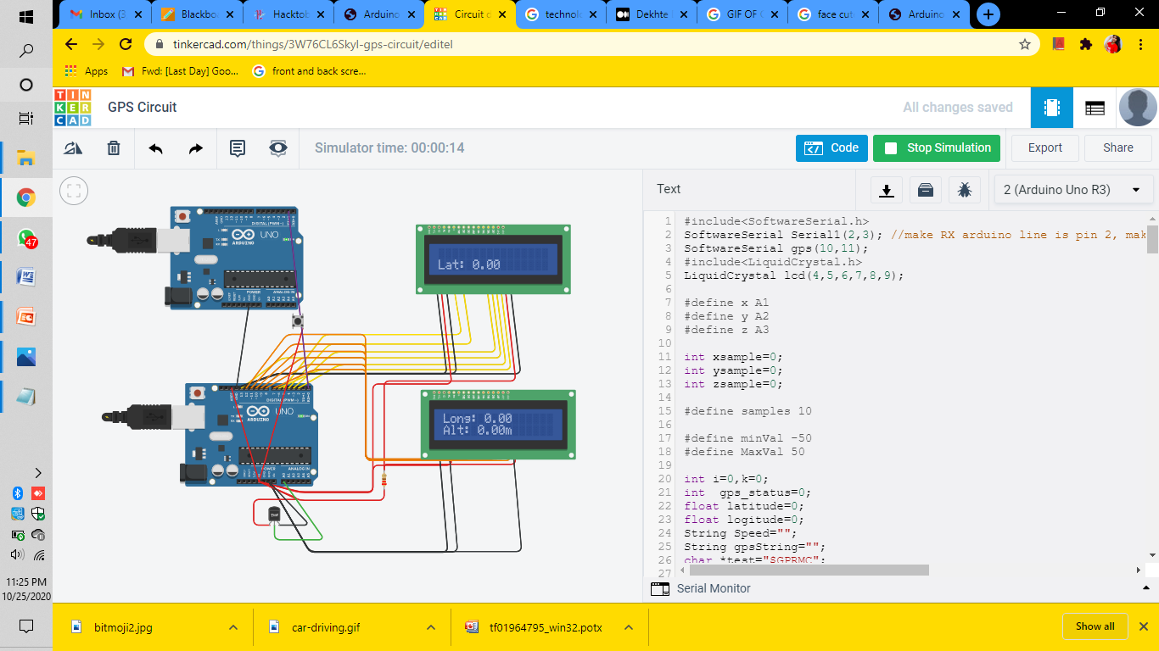
OUTPUT OF GPS SYSTEM :

Slide 10
THANK YOU
ANY QUESTIONS ?

